Slide 1
SDLC METHODOLOGIES
Prepared by: Datta
Kailash
Prasad
JAYANT

Slide 2
What are SDLC Methodologies?
SDLC Methodologies are processes and practices used by software development teams in order to successfully navigate the Software Development Life Cycle (SDLC).

Slide 3
Importance of SDLC :
SDLC allows developers to analyze the requirements.
work in defined customers timeframe.
It helps in reducing unnecessary costs during development. ... It enables developers to design and build high-quality software products.
This is because they follow a systematic process that allows them to test the software before it is rolled out.
Prathamesh Todkar

Slide 4
SDLC Phases:
Planning
Analysis
Designing
Coding
Testing
Deploy/Maintenance
Ketan Gorgile

Slide 5
Types of SDLC Methodologies:-
Waterfall :
V model :
Spiral :
Agile :
Scrum :
Iterative :

Slide 6
Waterfall
According to the Waterfall method, the software development process goes through all the SDLC phases with no overlapping and consists of a single development cycle.
According to the fact that it is a linear-sequential life cycle model, any phase in the development process can begin only if the previous one is complete.

Slide 7
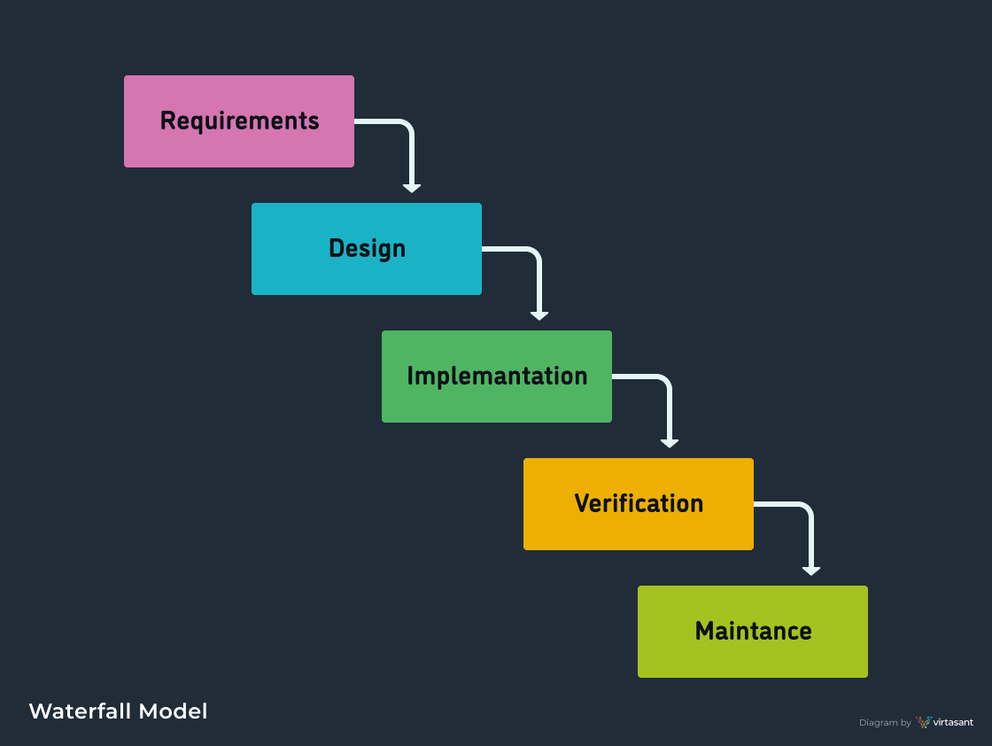
FLOWCHART : -

Slide 8
ADVANTAGES :-
A waterfall model is easy to implementation.
It helps to find errors earlier.
Easy to understand and use.
Works well when quality is most important than cost or schedule.
Documentation is produced at every stage of waterfall model allowing people to understand what has been done.
Testing is done at every stage.
Phases doesn’t overlap.

Slide 9
DISADVANTAGES :-
It is only suitable for small size projects not useful for complex.
Constant testing of design is needed.
If requirements may change the waterfall model may not work.
Difficult to estimate time and cost for each stage of the development process.
Adjust scope during the life cycle can kill a project.
High amount of risk and uncertainty.
The model is not suitable to handle dynamic changes in the requirements.

Slide 10
V model
Verification: It involves a static analysis method (review) done without executing code.
It is the process of evaluation of the product development process to find whether specified requirements meet.
Presented by: Chintan Mirajkar

Slide 11
Validation: It involves dynamic analysis method (functional, non-functional), testing is done by executing code.
Validation is the process to classify the software after the completion of the development process to determine whether the software meets the customer expectations and requirements.
Presented by: Prasad Gajmal

